Slide 1


Optimizing the carbon footprint in ‘Green IT Operations’
Sustainable IT Operations (SusOps)

Slide 2
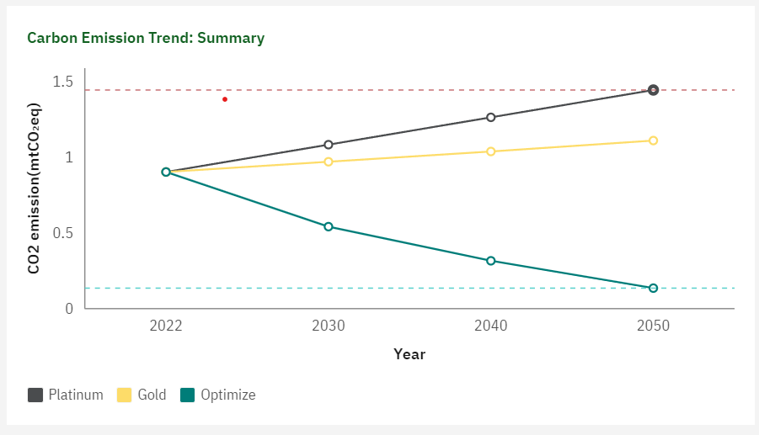
Insights-overview

Slide 3

O&G major
Executive Summary: Carbon footprint measurement of ticket lifecycle
Total Tickets:
Carbon :
PLATINUM: Tic
G :
Email Madhumithra
Email Madhumithra
Toal Applications
PLATINUM: Tic
G :
Email Madhumithra
Email Madhumithra
Generic Sustainabiilty Recommendations
Recommendated Autoation & AIOps solutions o optimize Co2

